Slide 1

PROJECT TIME MANAGEMENT

Slide 2
PROJECT TIME MANAGEMENT
Project time management involves the processes required to ensure/manage timely completion of a project.
It also known as schedule management knowledge area.
Project scheduling in a project refers to roadmap of all activities to be done with specified order and within time slot assigned to each activities.

Slide 3
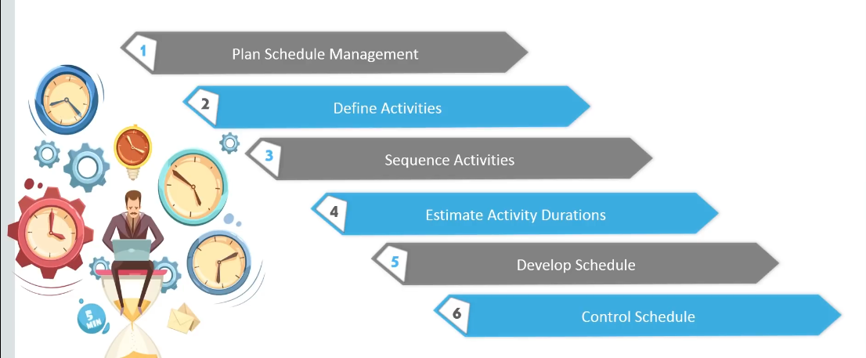
PROJECT TIME MANAGEMENT PROCESSES

Slide 4
PLAN SCHEDULE MANAGEMENT
Plan schedule management is the process of establishing the policies, procedures, and documentation for guiding project schedule.
This process helps in planning , developing ,managing and controlling the project schedule.
And also provides guidance and direction on how the project schedule will be managed throughout the project life cycle.

Slide 5
WHERE DO SCHEDULES COME FROM?
Basic document that initiate a project schedules:
  Project charter (includes start and end dates and budget information)
  Scope statement and WBS helps to define what will be done in a project.

Slide 6
DEFINING ACTIVITIES
Defining Activities is the process of identifying and documenting the specific action/ activities that must be performed to produce various project deliverables/outputs.
It breaks down the work packages into activities.
It provides base for estimating ,scheduling ,executing , monitoring and controlling the project work.

Slide 7
SEQUENCE ACTIVITY
It is the process of identifying and documenting relationships among the project activities.
Activity's are arranged in order that they should be performed with each activity having a predecessor and successor ,except for the first and last activities.

Slide 8
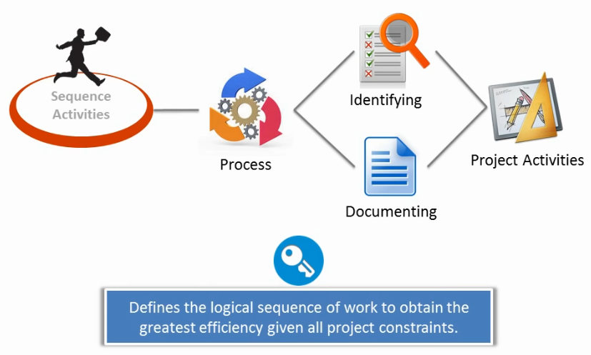
CONTT..

Slide 9
CONTT…
It involves reviewing activities and determining dependencies between activities.
  Mandatory dependencies: inherent in the nature of the work; hard logic
  Discretionary dependencies: defined by the project management team; soft logic
  External dependencies: involve relationships between project and non-project activities
You must determine dependencies in order to use critical path analysis.

Slide 10
PROJECT NETWORK DIAGRAMS
Project network diagrams are the preferred technique for showing activity sequencing.
A project network diagram is a graphical display of logical relationships/sequencing among project activities.
It can be arrow(ADM) or precedence(PDM) diagramming method.

Slide 11
ARROW DIAGRAMMING METHOD (ADM)
Also called activity-on-arrow (AOA) project network diagrams
Activities are represented by arrows
Nodes or circles are the starting and ending points of activities
Can only show finish-to-start dependencies

Slide 12
PROCESS FOR CREATING AOA DIAGRAMS
1. Find all of the activities that start at node 1. Draw their finish nodes and draw arrows between node 1 and those finish nodes. Put the activity letter or name and duration estimate on the associated arrow
2. Continue drawing the network diagram, working from left to right. Look for bursts and merges. Bursts occur when a single node is followed by two or more activities. A merge occurs when two or more nodes precede a single node
3. Continue drawing the project network diagram until all activities are included on the diagram that have dependencies
4. As a rule of thumb, all arrowheads should face toward the right, and no arrows should cross on an AOA network diagram

Slide 13
EXAMPLE 1- A SIMPLE NETWORK
Consider the list of four activities for making a simple product:
Activity Description Immediate
predecessors
A Buy Plastic Body -
B Design Component -
C Make Component B
D Assemble product A,C
Immediate predecessors for a particular activity are the activities that, when completed, enable the start of the activity in question.

Slide 14
SEQUENCE OF ACTIVITIES ARE:
Can start work on activities A and B anytime, since neither of these activities depends upon the completion of prior activities.
Activity C cannot be started until activity B has been completed
Activity D cannot be started until both activities A and C have been completed.
The graphical representation (next slide) is referred to as activity-on-arrow (AOA)/ PERT/CPM network diagram.

Slide 15
NETWORK OF FOUR ACTIVITIES
Arcs indicate project activities
A
D
1
3
4
B
C
2
Nodes correspond to the beginning and ending of activities

Slide 16
Activities | Immediate Predecessors | Expected time
A | - | 1
B | - | 2
C | - | 3
D | A | 4
E | B | 5
F | B | 4
G | C | 6
H | D,E | 6
I | G | 2
J | F,H,I | 3
Draw Network diagram for the above data (AoA).
Identify the critical path.
Compute the total time to complete this project.
Compute slack time of this project.

Slide 17
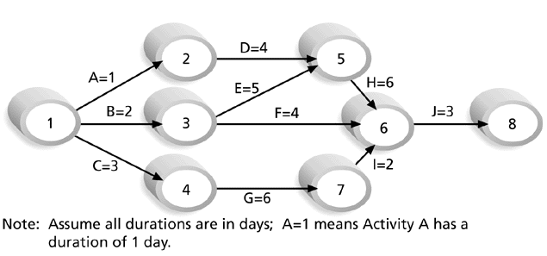
SAMPLE ACTIVITY-ON-ARROW (AOA) NETWORK DIAGRAM FOR PROJECT X

Slide 18
PRECEDENCE DIAGRAMMING METHOD (PDM)
Activities are represented by boxes
Arrows show relationships between activities
More popular than ADM method and used by project management software.
Better at showing different types of dependencies

Slide 19
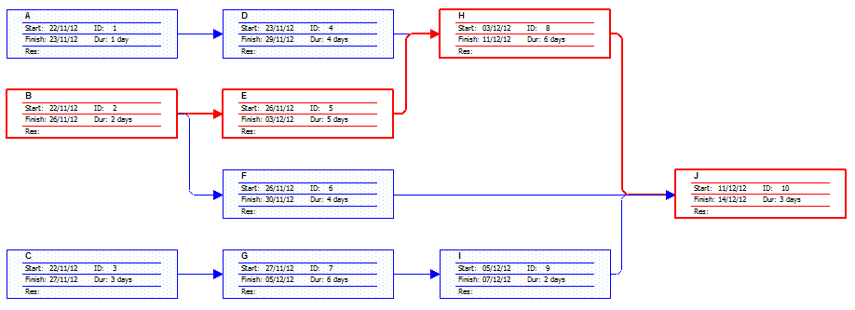
SAMPLE NETWORK DIAGRAM( PDM)/(AoN)
Project X

Slide 20
ESTIMATING ACTIVITY DURATION
After defining activities and determining there sequence, the next step in time management is duration estimating.
It is the process of estimating the number of work period needed to complete individual activities with estimated resources.
Duration includes the actual amount of time worked on an activity plus elapsed time.

Slide 21
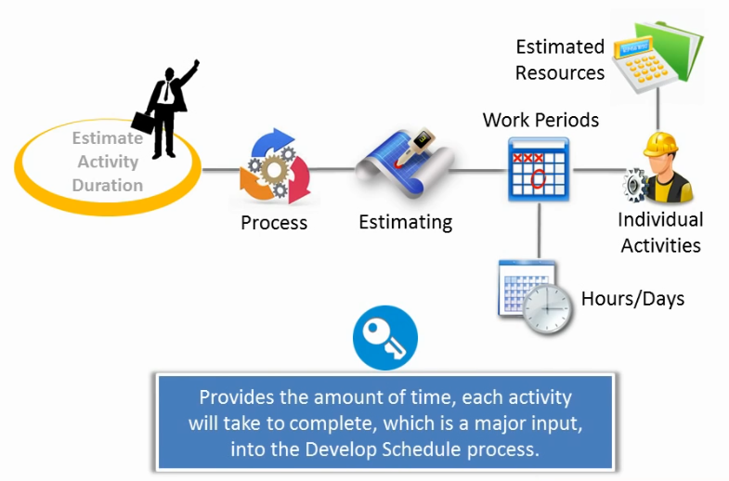
CONTT…

Slide 22
PROGRAM EVALUATION AND REVIEW TECHNIQUE /PERT/
It important tools and techniques used to define an approximate range of activities duration.
PERT uses probabilistic time estimates based on using optimistic, most likely, and pessimistic estimates of activity durations.

Slide 23
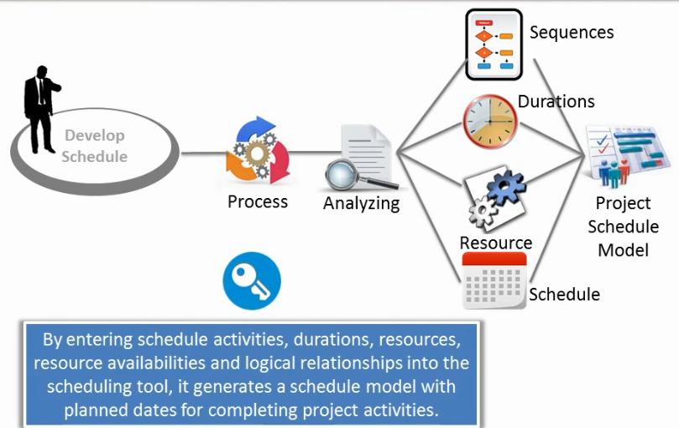
SCHEDULE DEVELOPMENT

Slide 24
CONTT…
Schedule development uses results of the other time management processes to determine the start and end date of the project and its activities
Schedule converts action plan into operating time table.
Ultimate goal is to create a accurate project schedule (time table) that provides a basis for monitoring project progress.
Important tools and techniques include Gantt charts, PERT analysis, critical path analysis, and critical chain scheduling….

Slide 25
GANTT CHARTS
Gantt charts provide a standard format for displaying project schedule info by listing project activities and their corresponding start and finish dates in a calendar/table format.
It represent project schedule with respect to time periods.
Symbols include:
  Thick black bars: summary tasks
  horizontal bars: tasks/work

Slide 26
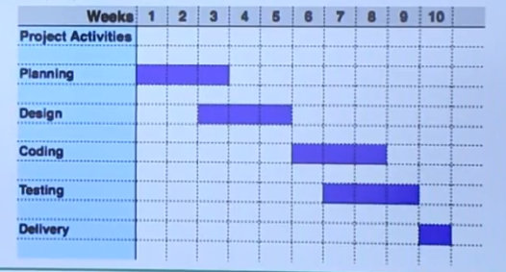
GANTT CHART FOR PROJECT X

Slide 27
CRITICAL PATH METHOD (CPM)
CPM is a project network analysis technique used to predict total project duration
A critical path for a project is the series of activities that determines the earliest time by which the project can be completed.
The critical path is longest path through the network diagram and has least amount of slack or float( St==0).

Slide 28
FINDING THE CRITICAL PATH
First develop a good project network diagram for all activities.
Add durations for all activities on each path through project network diagram.
The longest path is the critical path as shown in example below…….

Slide 29
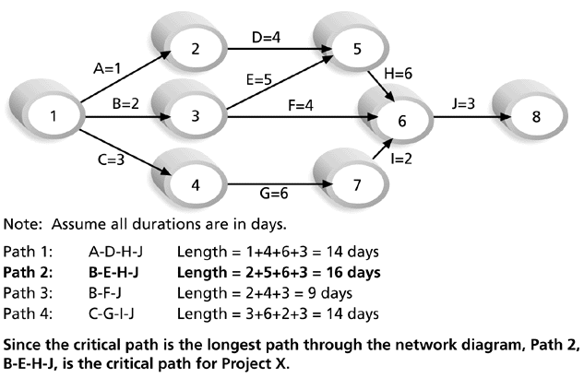
EXAMPLE CRITICAL PATH FOR PROJECT X
Total time to complete the project is 16 days.

Slide 30
MORE ON THE CRITICAL PATH
If one of more activities on the critical path takes longer than planned, the whole project schedule will slip unless corrective action is taken.
Misconceptions:
  The critical path is not the one with all the critical activities; it only accounts for time
  There can be more than one critical path if the lengths of two or more paths are the same
  The critical path can change as the project progresses

Slide 31
TECHNIQUES FOR SHORTENING A PROJECT SCHEDULE
Shortening durations of critical tasks for adding more resources or changing their scope.
Crashing tasks by obtaining the greatest amount of schedule compression for the least incremental cost or changing their scope.
Fast tracking : by doing tasks in parallel or overlapping them.

Slide 32
PERT ANALYSIS &CRITICAL CHAIN SCHEDULING
Reading Assignment

Slide 33
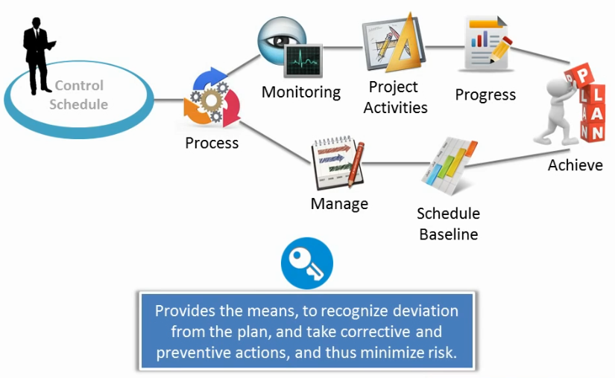
CONTROL SCHEDULE

Slide 34
CLASS WORK
Activity Immediate Completion
predecessors Time (week)
A - 5
B - 6
C A 4
D A 3
E A 1
F E 4
G D,F 14
H B,C 12
I G,H 2
Total …… 51
This information indicates that the total time required to complete activities is 51 weeks. However, we can see from the network that several of the activities can be conducted simultaneously (A and B, for example).

Slide 35
IMPORTANT QUESTIONS
Draw Network diagram/PRET/CPM for the above data (AoA)?
What is the total time to complete the project?
  26 weeks if the individual activities are completed on schedule.
What are the scheduled start and completion times for each activity?
  ES, EF, LS, LF are given for each activity.
What activities are critical and must be completed as scheduled in order to keep the project on time?
  Critical path activities: A, E, F, G, and I.
Compute slack time of this project?
  Slack time available for all activities are given.

Slide 36
EARLIEST START & EARLIEST FINISH TIME
We are interested in the longest path through the network, i.e., the critical path.
Starting at the network’s origin (node 1) and using a starting time of 0, we compute an Earliest Start (ES) and Earliest Finish (EF) time for each activity in the network.
Using expression EF = ES + t for finding Earliest Finish time for a given activity.
For example, for activity A, ES = 0 and t = 5; thus the Earliest Finish time for activity A is
EF = 0 + 5 = 5

Slide 37
ARC WITH ES & EF TIME
EF = earliest finish time
ES = earliest start time
Activity
2
A [0,5]
5
1
t = expected activity
time

Slide 38
ACTIVITY, DURATION, ES, EF, LS, LF
EF = earliest finish time
ES = earliest start time
Activity
3
C [5,9]
4 [8,12]
2
LF = latest finish time
LS = latest start time

Slide 39
LATEST START & LATEST FINISH TIME
To find the critical path we need backward pass calculation.
Starting at the completion point (node 7) and using a Latest
Finish time (LF) of 26 for activity I, we trace back through the network computing a Latest Start (LS) and Latest Finish time for each activity.
The expression LS = LF – t can be used to calculate latest start time for each activity.
For example, for activity I, LF = 26 and t = 2, thus the Latest Start time for activity I is :
LS = 26 – 2 = 24

Slide 40
NETWORK WITH LS & LF TIME
D[5,8]
3[7,10]
5
2
G[10,24] 14[10,24]
F[6,10]
4[6,10]
A[0,5]
5[0,5]
E[5,6]
1[5,6]
7
4
I[24,26]
2[24,26]
C[5,9]
4[8,12]
1
6
B[0,6]
6[6,12]
H[9,21]
12[12,24]
3
Latest Finish time rule:
The Latest Finish time for an activity entering a particular node is equal to the smallest of the Latest Start times for all activities leaving the node.

